Slide 1

Hardware device : Portable Device

Slide 2
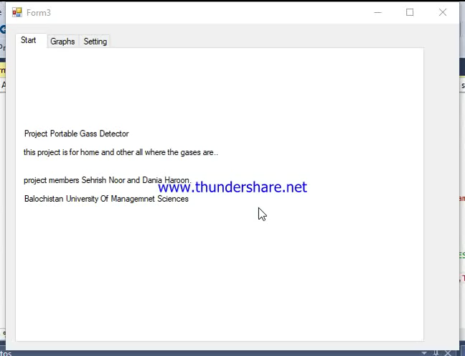
Desktop Application

Slide 3
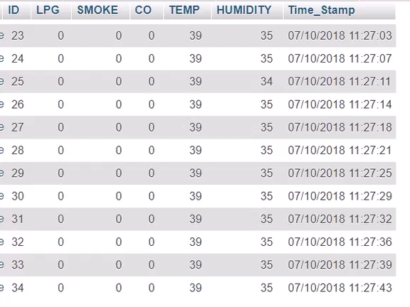
Database Of desktop application data

Slide 4
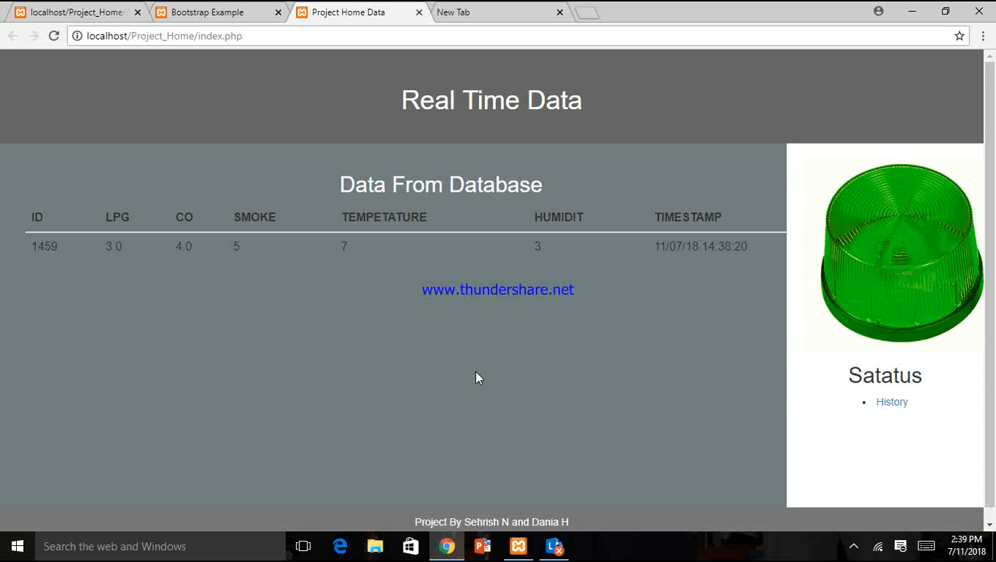
Normal Status

Slide 5
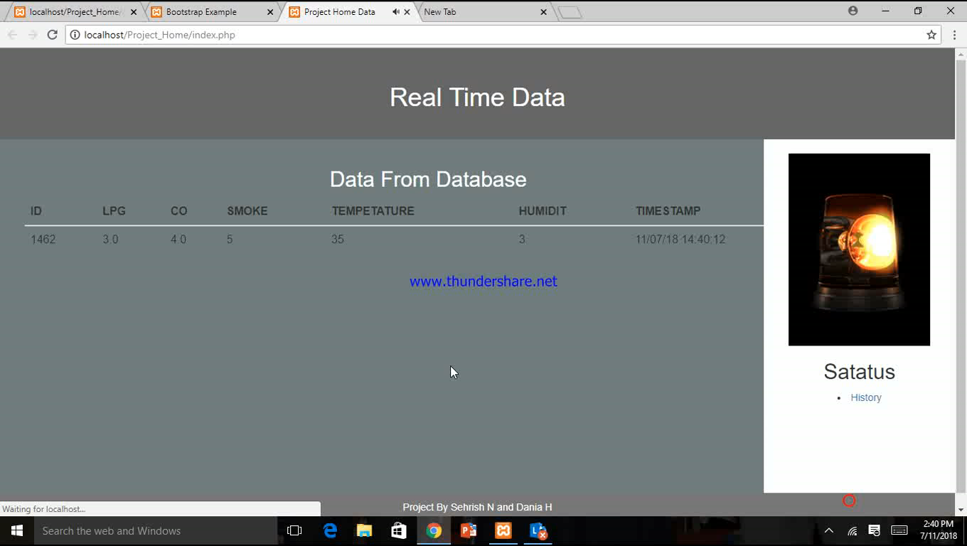
Warning Of High Temp

Slide 6
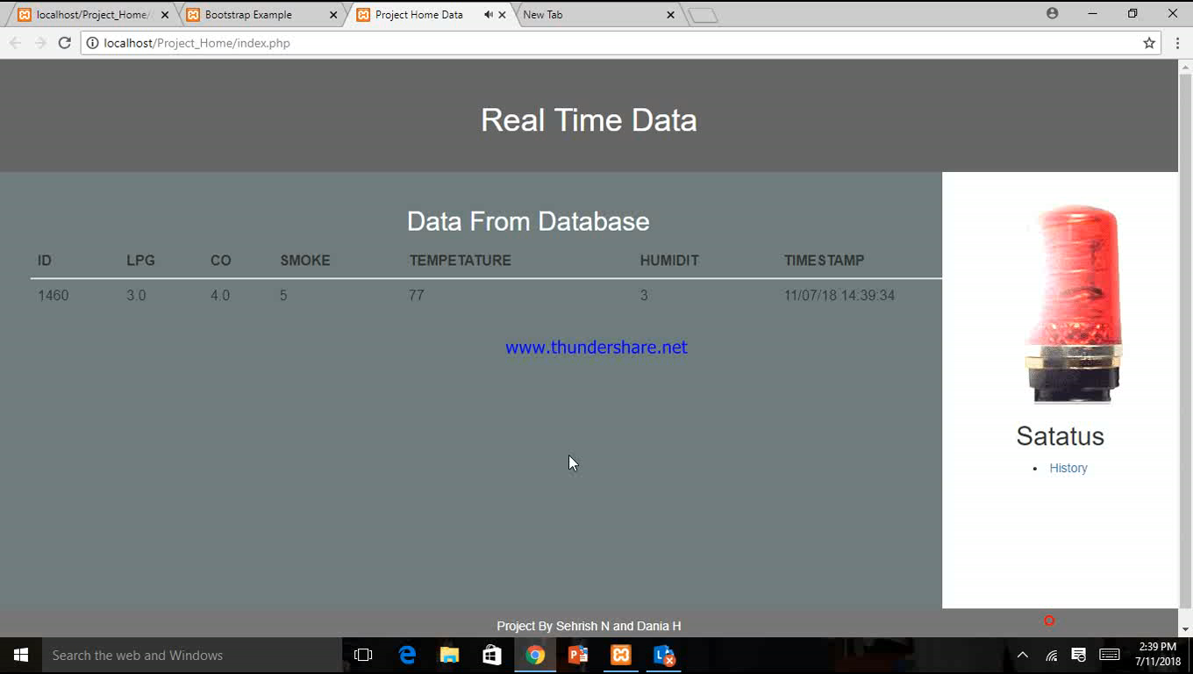
Danger Of High Temp

